Slide 1
MPPC
(64ch)
MPPC
(64ch)
CIRASAME module
40V-70V
ASIC
(32ch)
ASIC
(32ch)
ASIC
(32ch)
ASIC
(32ch)
Probe
output
MAX
19232
Comparator
output
Analog high-gain
output
128
FPGA
DIP Switch
4
Analog
switch
SDRAM
GTX
AD9220
2
2
Logic
translate
Jitter
cleaner
Logic
translate
Power
supply
NIM
SFP1
SFP2
Coaxial
Coaxial
Coaxial
Coaxial
DC +20-35V

Slide 2
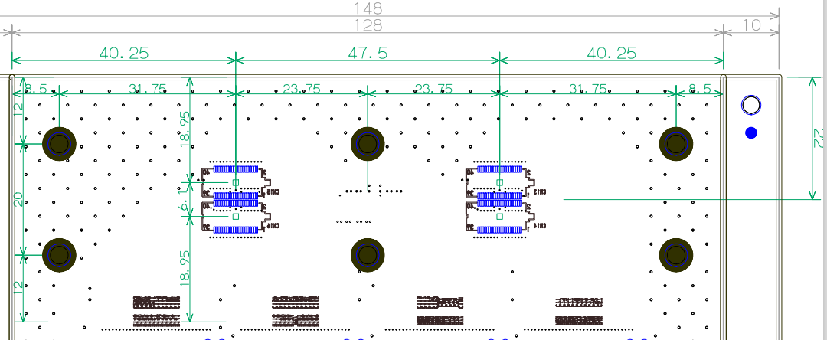
40.25
47.5
40.25
8.5
31.75
23.75
23.75
31.75
8.5
15
22
18.95
6.1
20
18.95
15

Slide 3
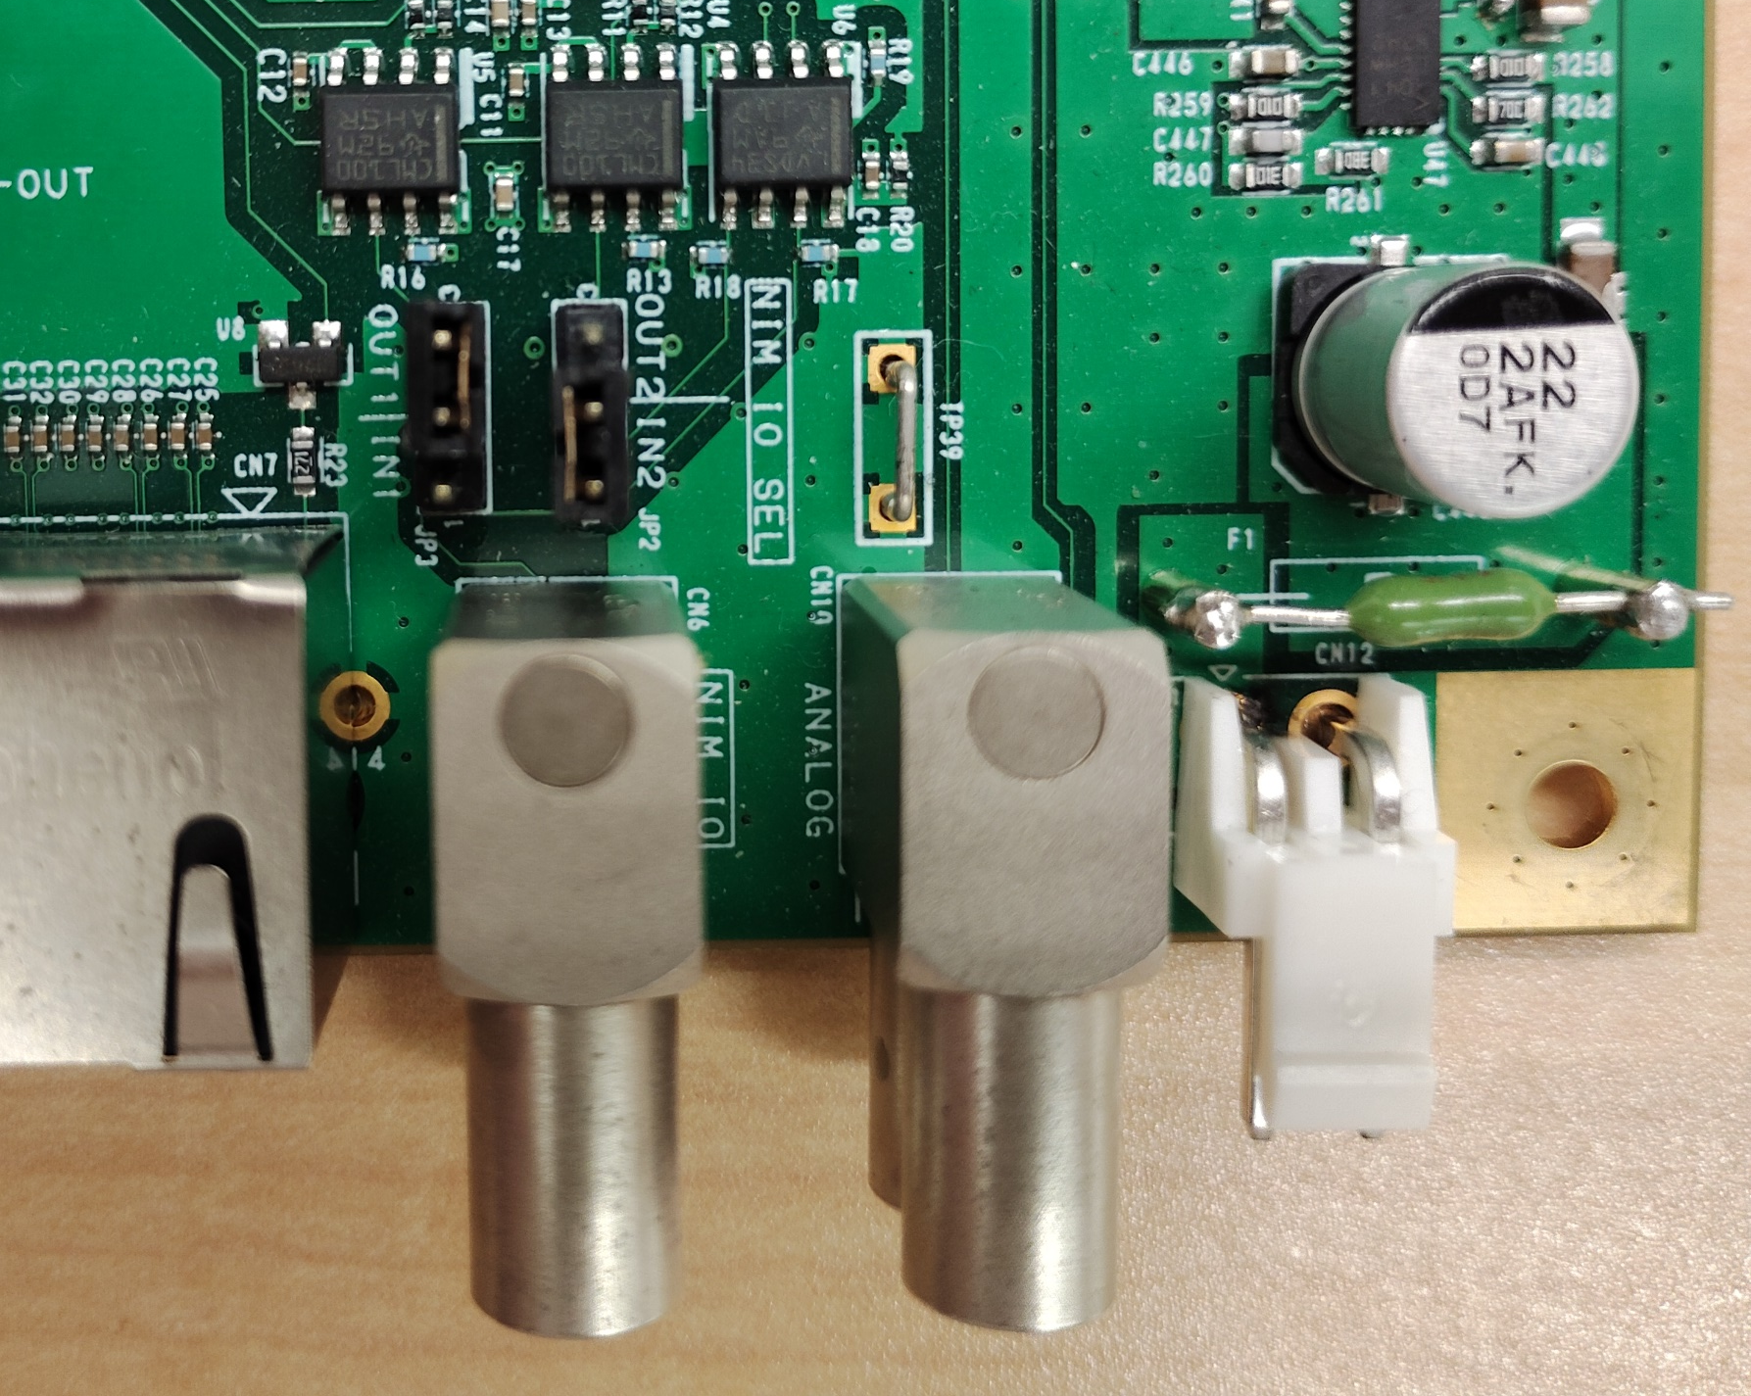
Analog/probe out
NIM IO

Slide 4
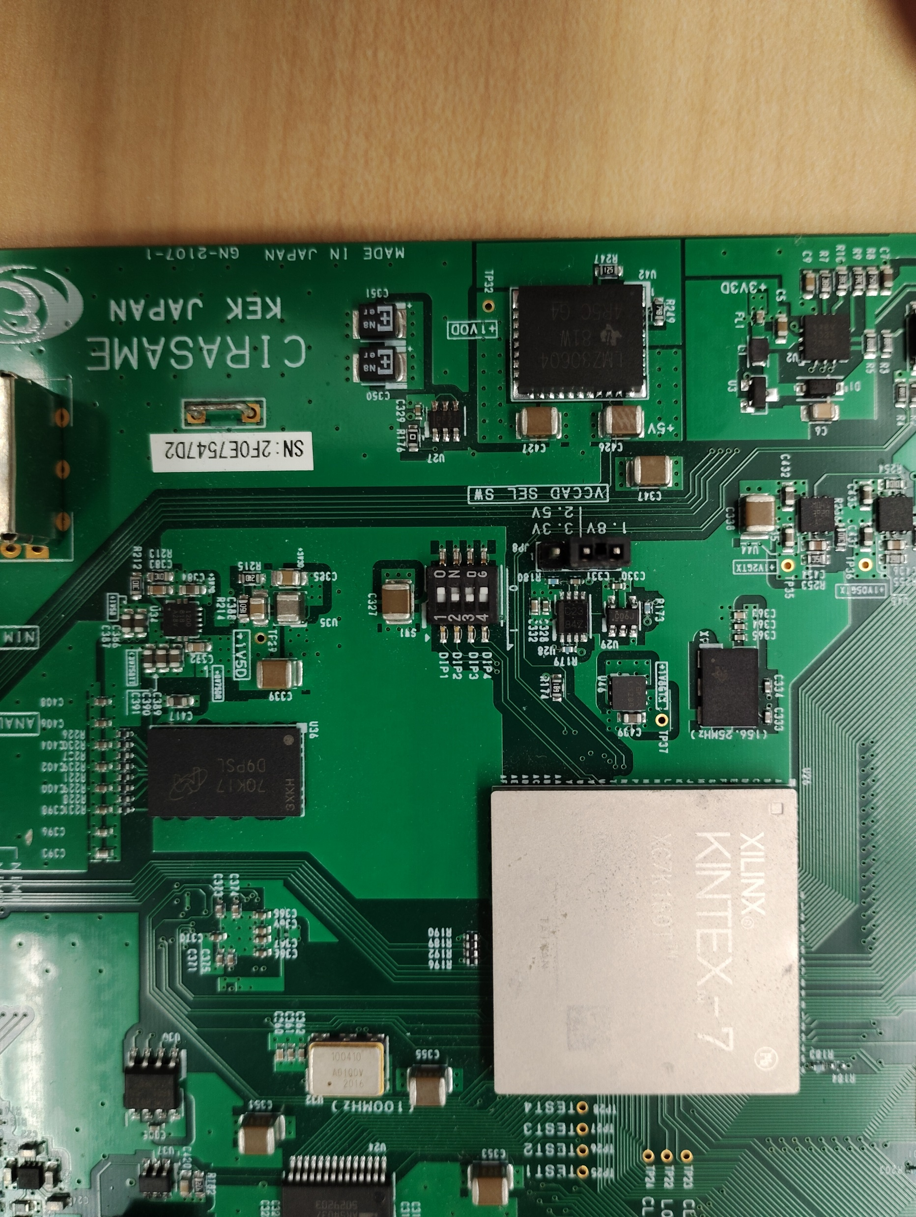

Slide 5
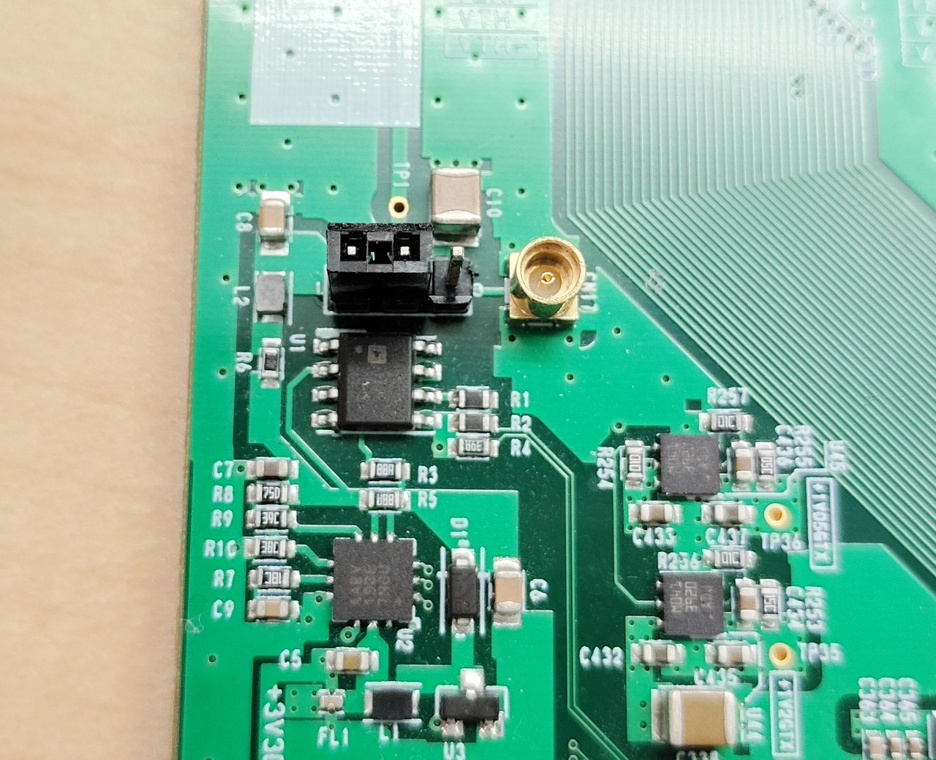
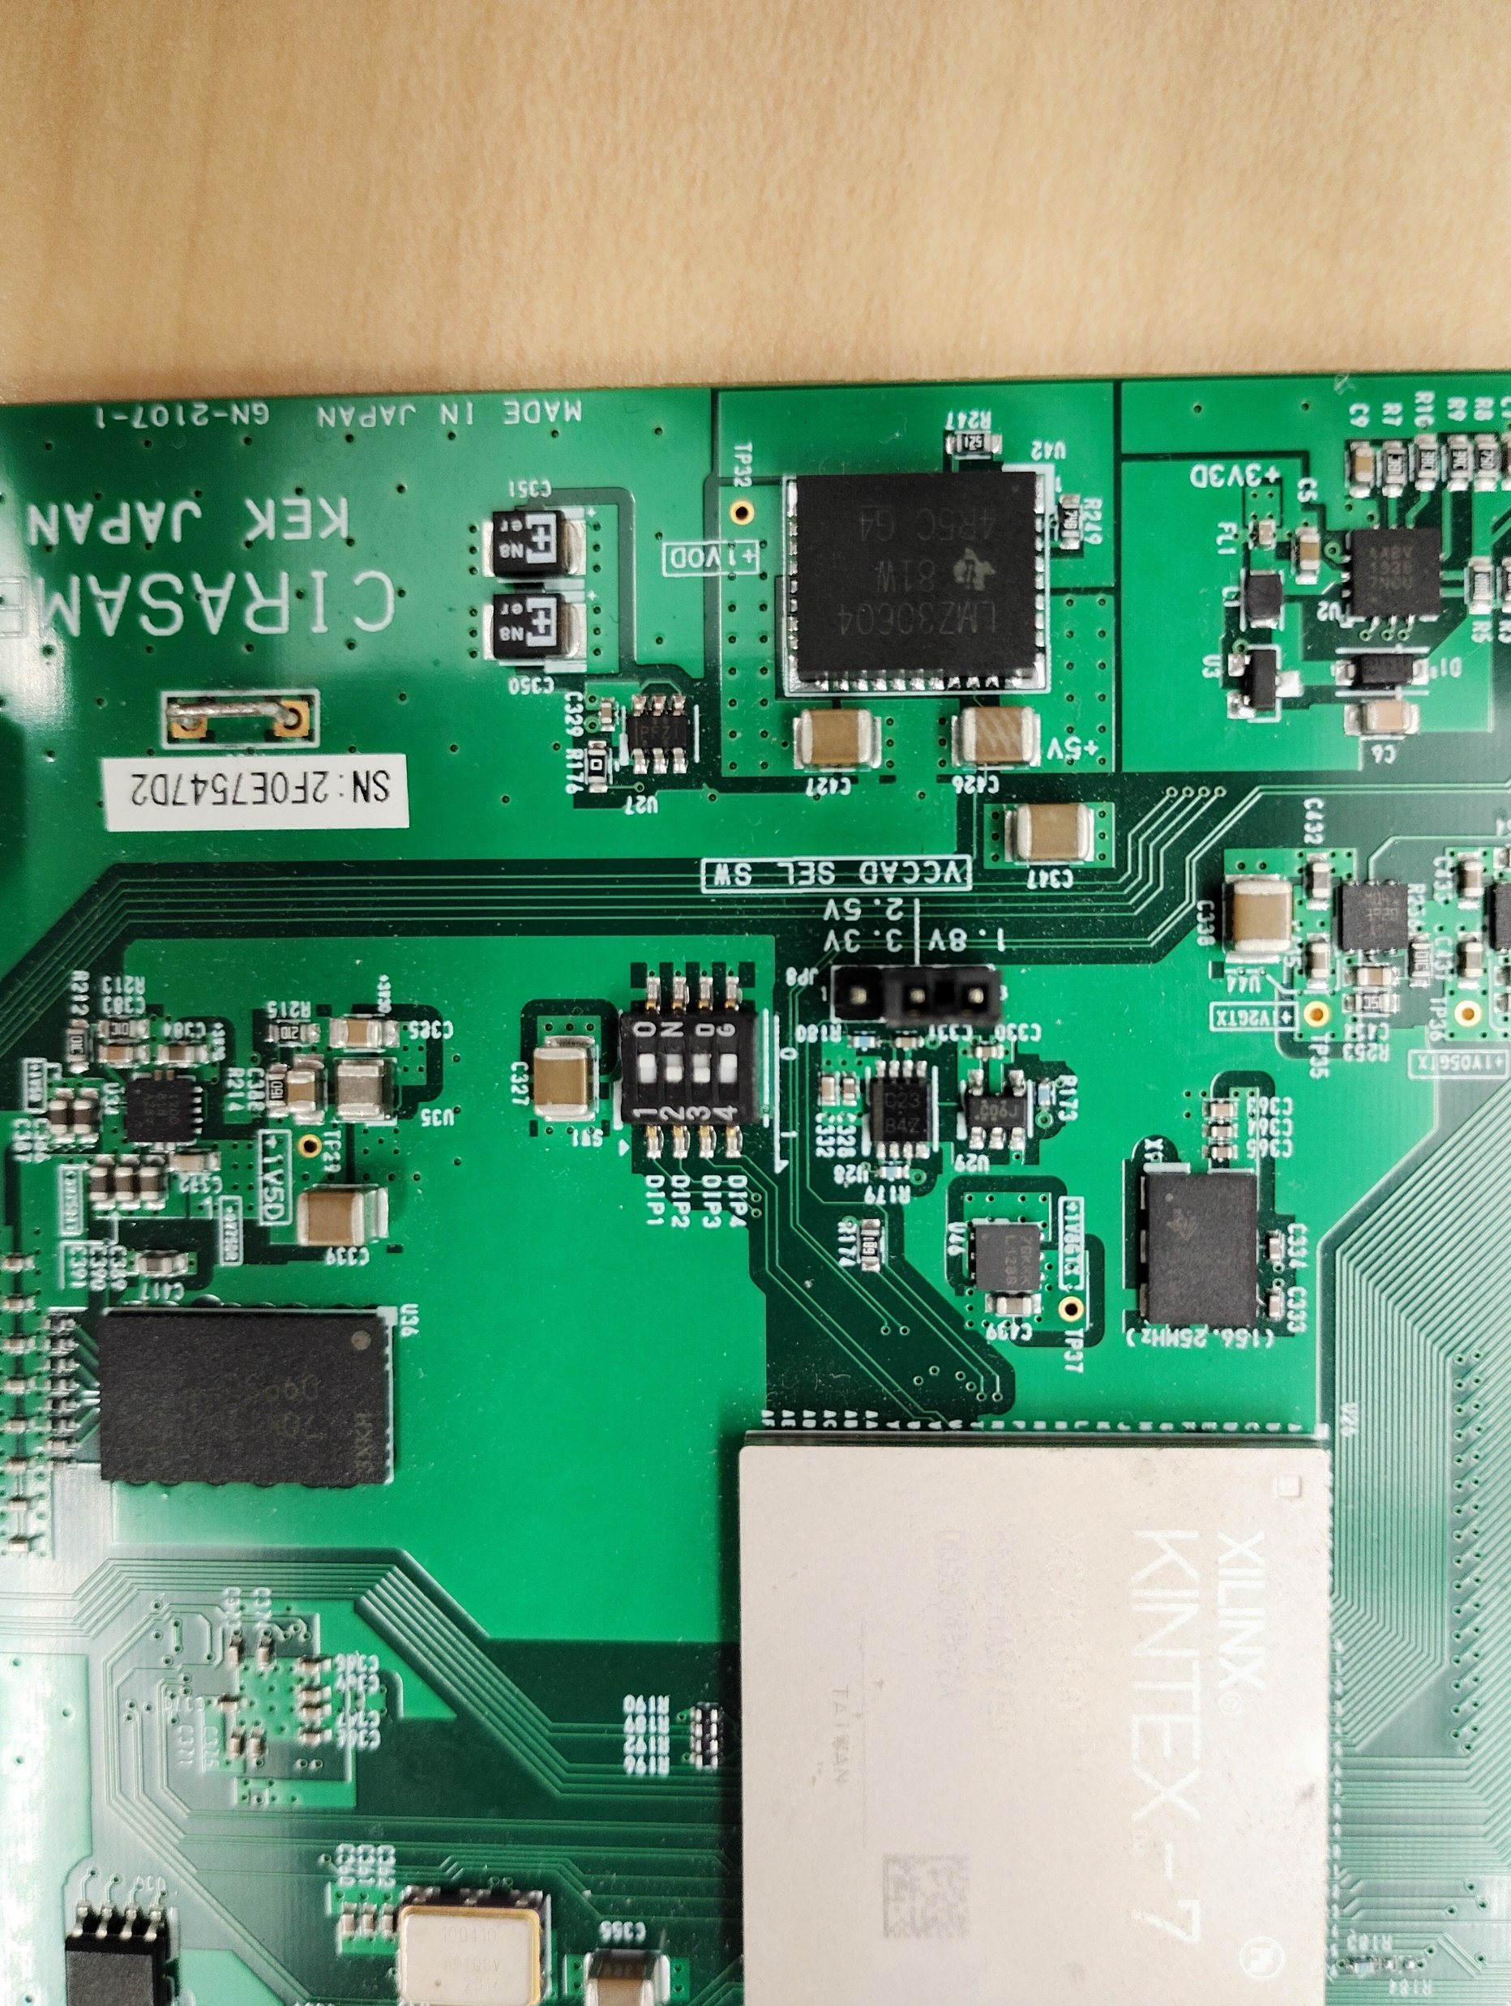
Bias selection
External bias

Slide 6
Streaming
TDC
SiTCP
TCP
Scaler
RBCP
IO
Manger
Heartbeat
Unit
LACCP
MIKUMARI
NIMIN-1
System
clock
MMCM
Local oscillator clock
NIMIN-2
Trigger

Slide 7
Oscillator
100MHz
MMCM
Local clock
domain
PCS/PMA
SFP
NIM-OUT 1
NIM-IN2
Local bus
SiTCP/XG
Hold
Generator
TCP
NIM-OUT 2
HOLD
CITIROCs
IO Manager
RBCP
128
Analog output
CDC
AD9220
AD9220
CITIROC
Controller
MPPC bias
MAX1932
MAX1932
Controller
Local bus
controller
CECE
62002
CECE62002
Controller
Inside
FPGA
Flash
memory
FMP
SDS
SEM
XADC

Slide 8
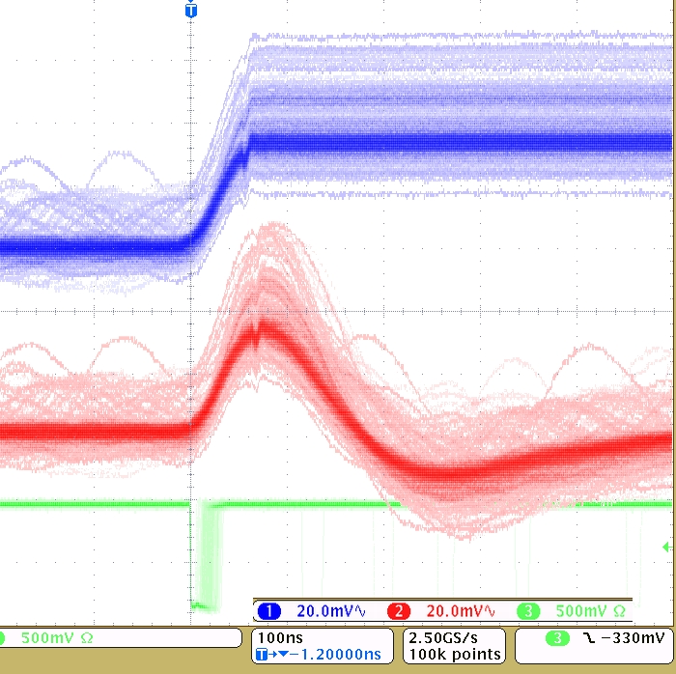
Smaller delay amount
Analog output
w/ HOLD
Incoming HOLD signal
MSB
LSB
Mask register:
11111111’11111111’11110000’00000000
Probe signal
(Slow Shaper output)
Larger delay amount
MSB
LSB
Mask register:
11111110’00000000’00000000’00000000

